Slide 1
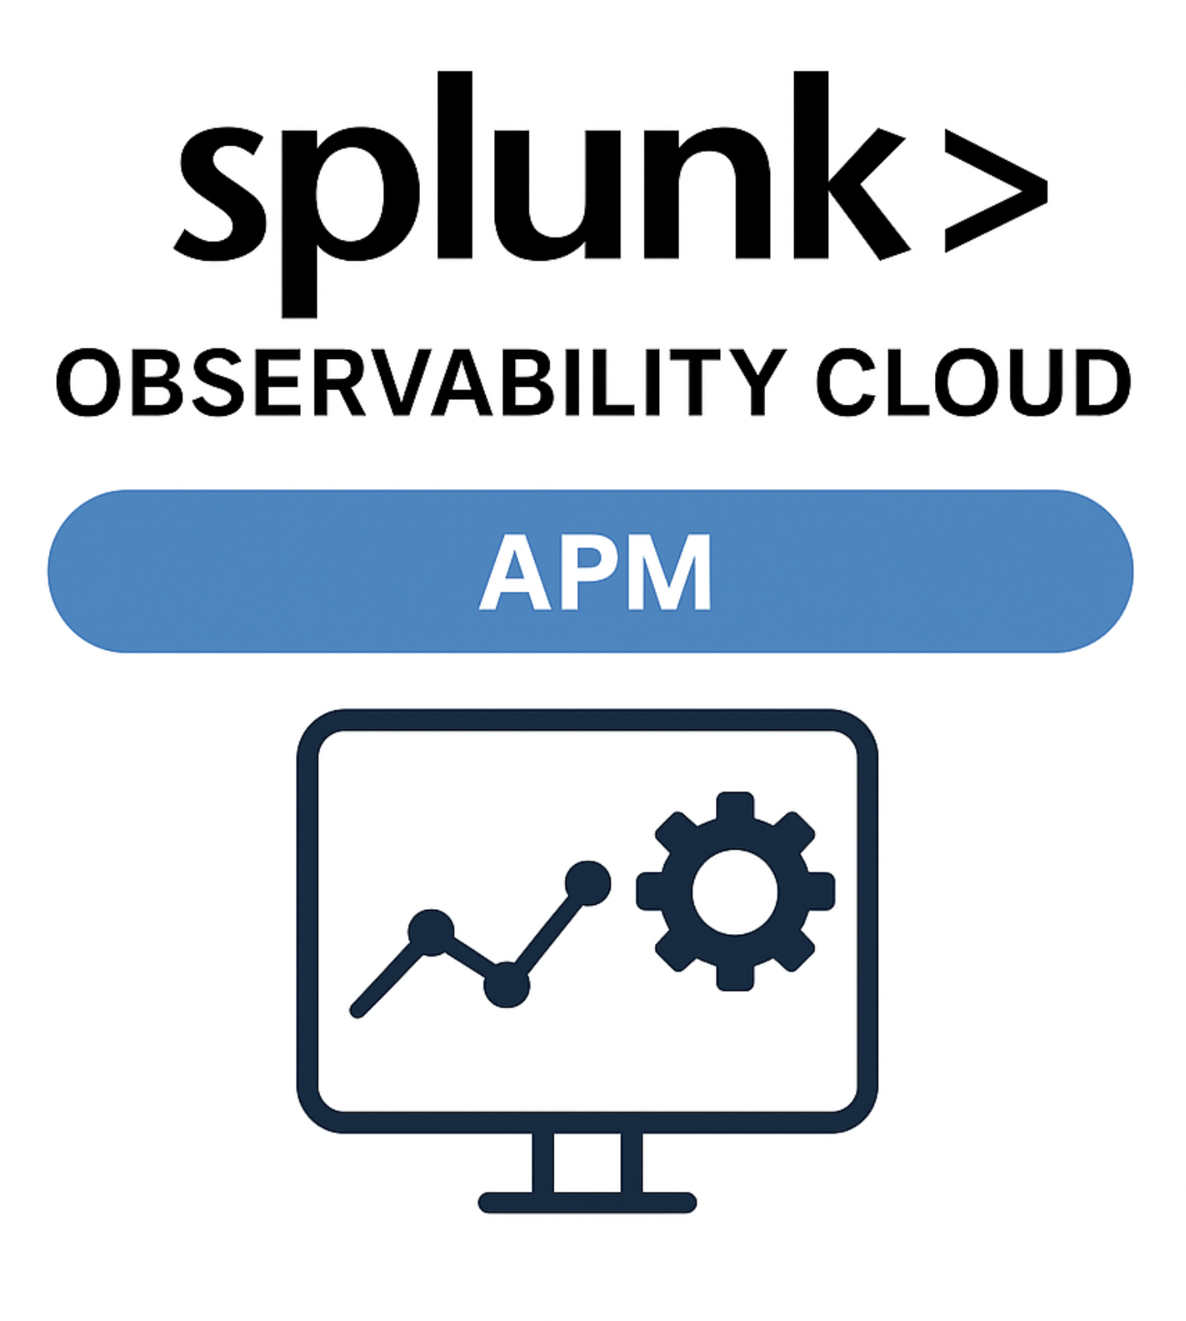
Splunk Observability Cloud

Slide 2
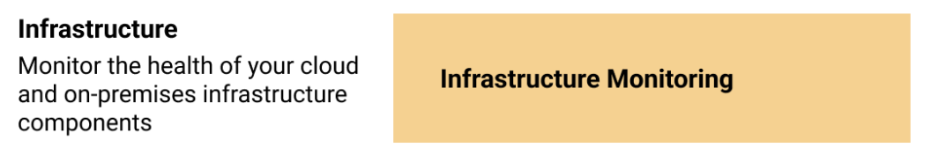
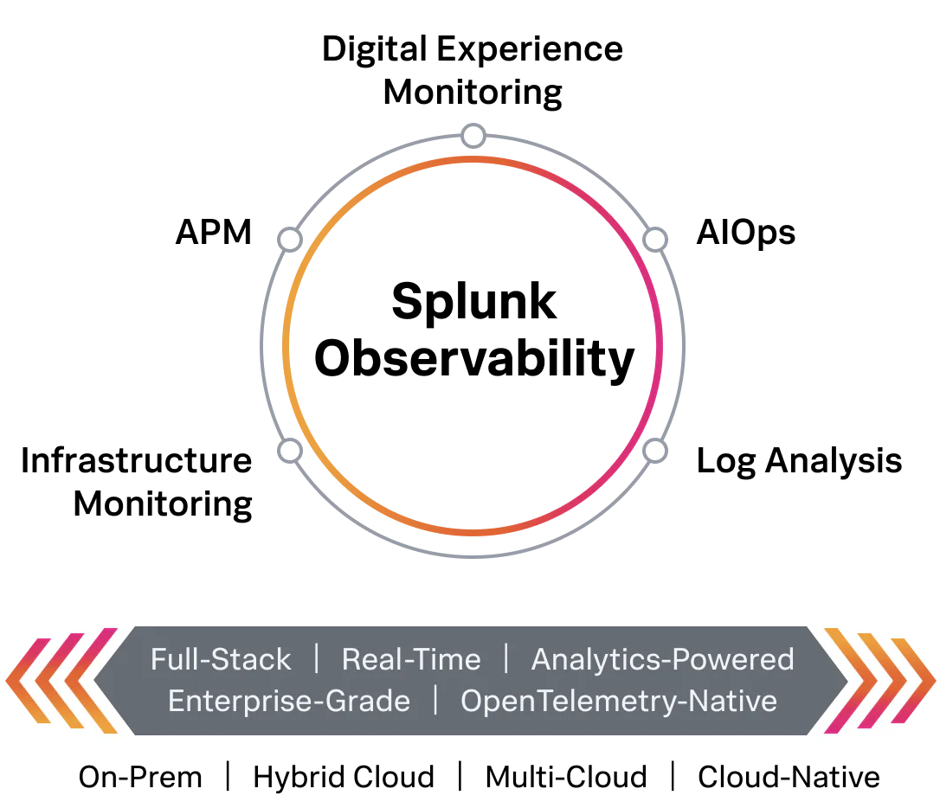
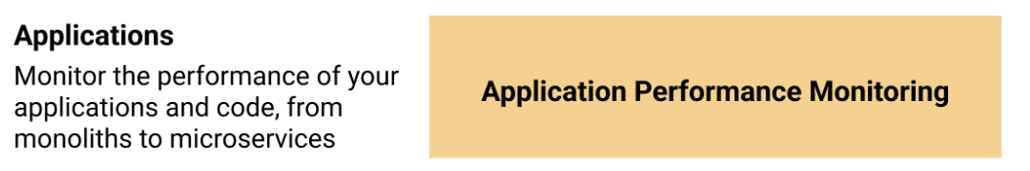


Splunk Observability Cloud / Splunk O11y
Splunk Observability Cloud provides full stack of monitoring and troubleshooting across infrastructure, applications, and user interfaces etc in almost real-time and help us keep our services or infrastructure reliable.
RUM

Slide 3
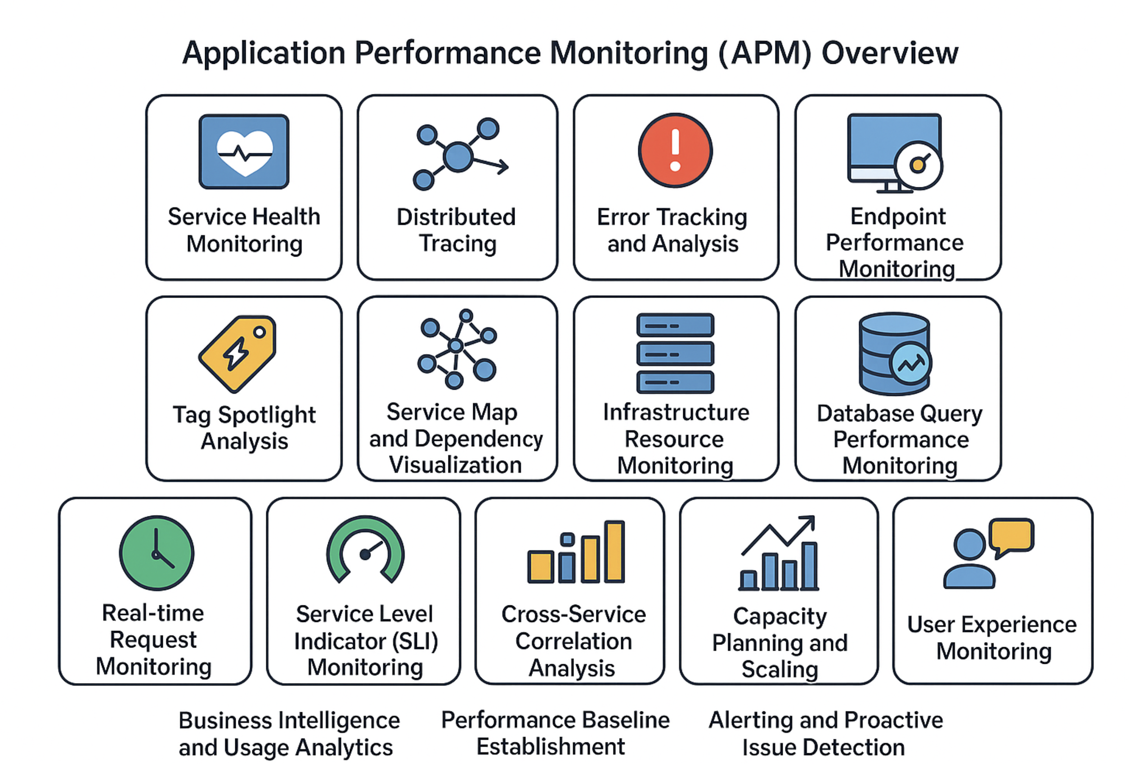
List of APM Use Cases

